Slide 1
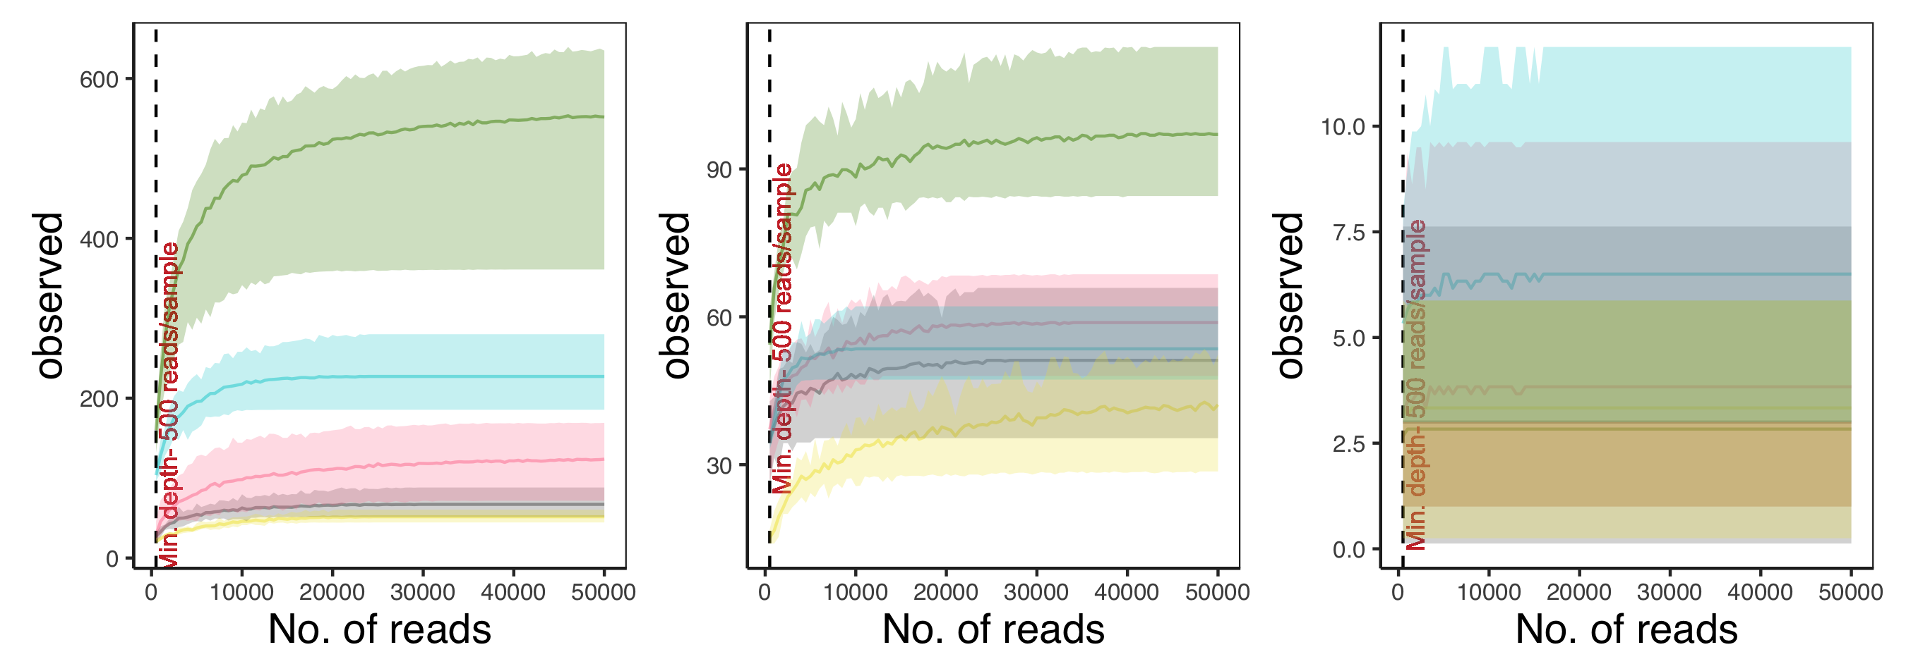
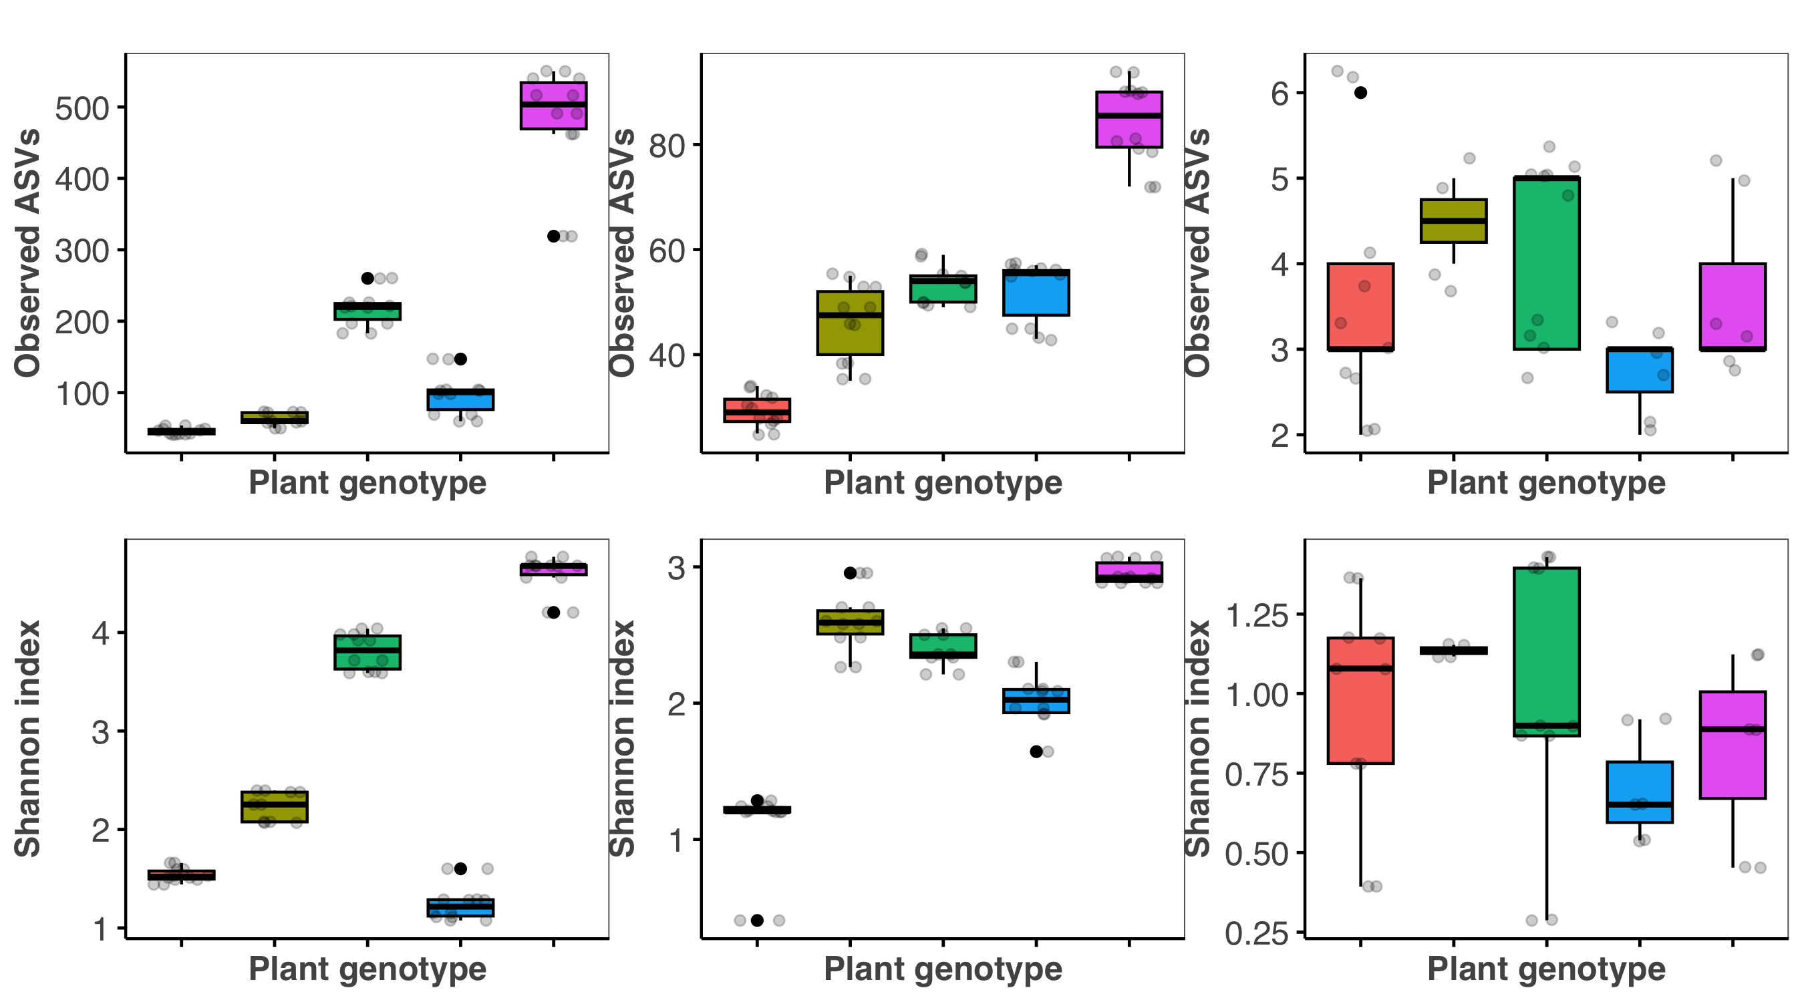
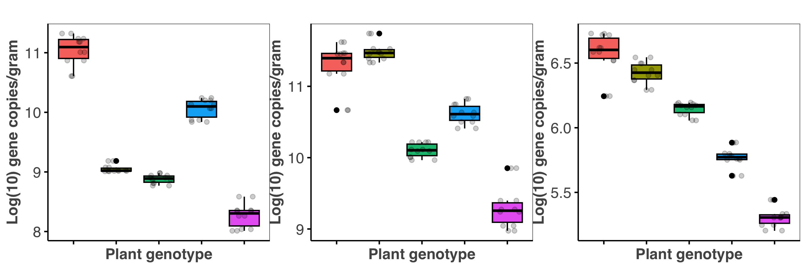
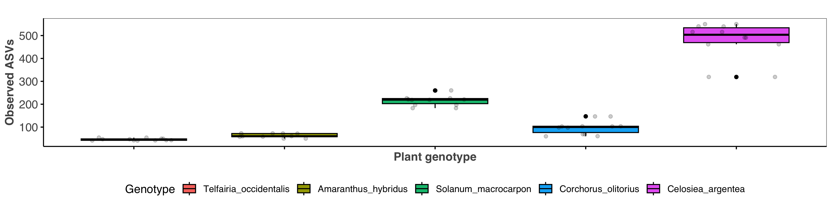
A
Bacterial community
E
Fungal community
I
Archaeal community
Richness
Richness
Richness
B
KW: p= 2.905e-05
c
F
KW: p= 0.04
b
J
KW: p= 0.496
a
a
a
ac
a
ab
ab
a
abc
a
a
b
ab
C
KW: p= 2.905e-05
a
G
KW: p= 0.02
a
K
a
a
KW: p= 0.496
ac
ab
abc
a
a
bc
a
abc
c
bc
b
D
c
KW: p= 1.325e-05
H
ac
a
KW: p= 0.001
L
b
KW: p= 2.905e-05
ab
bc
abc
abc
bc
ac
abc
ab
b
a
c
Telfairia occidentalis
Amaranthus hybridus
Solanum macrocarpon
Corchorus olitorius
Celosiea argentea

Slide 2
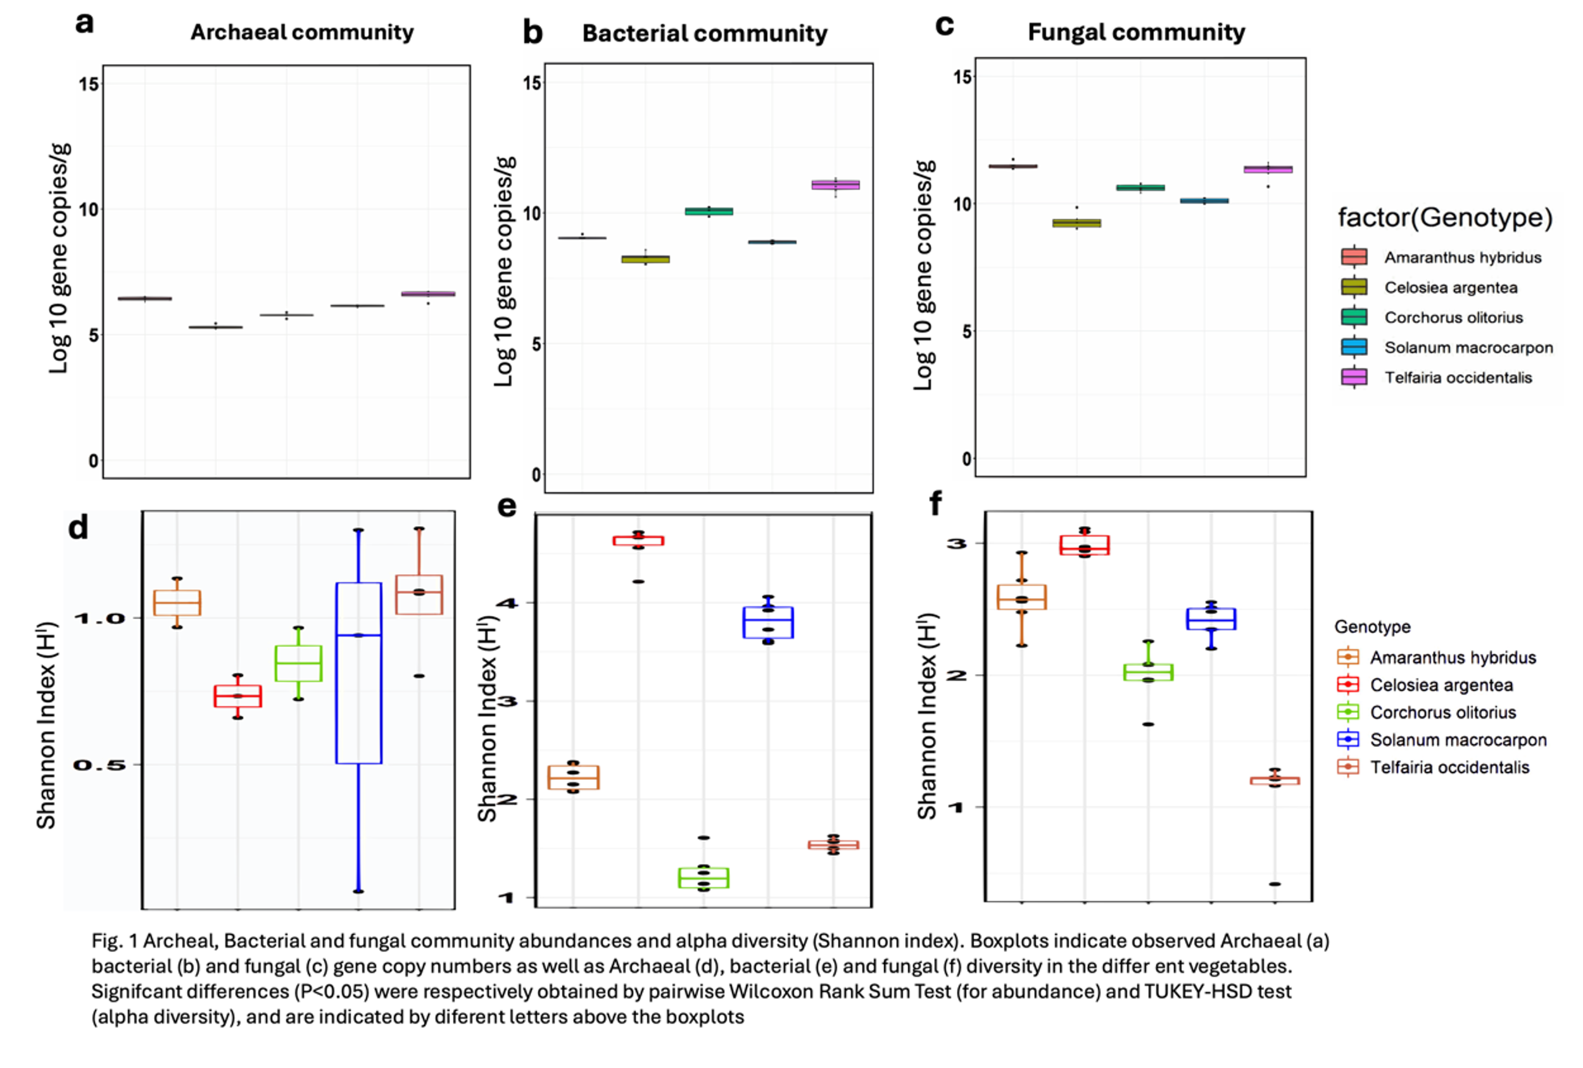

Slide 3
